Slide 1
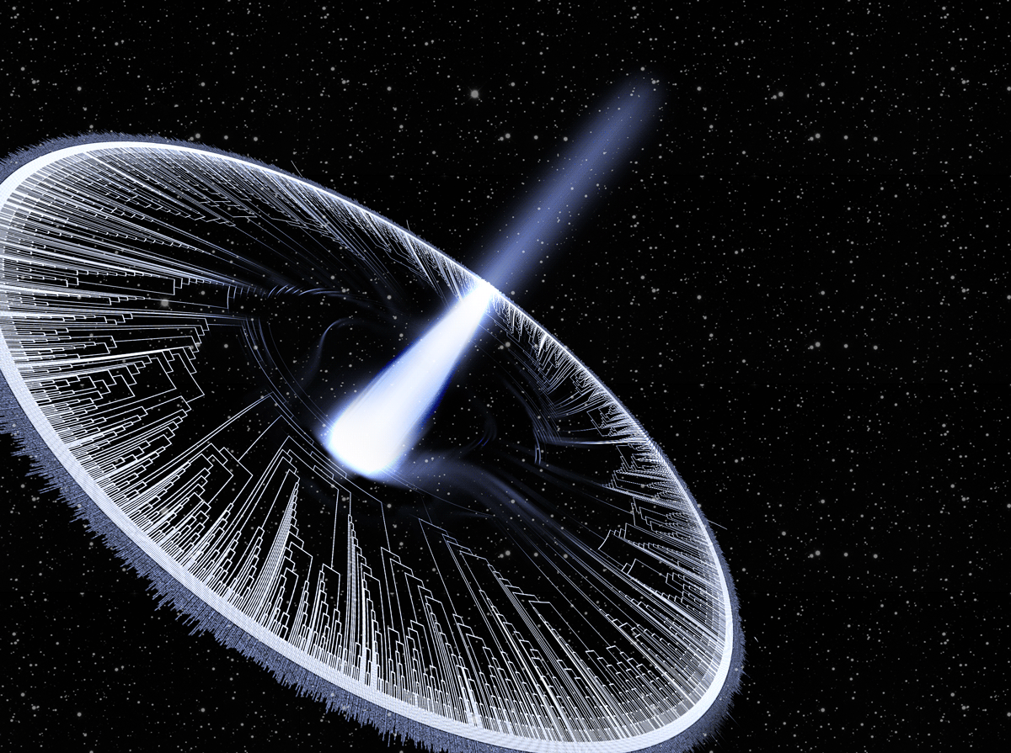
Macroevolution & Phylogenetics

Slide 2
Goals of the course:
1. Learn how to estimate trees
2. Learn how to use trees
3. Learn about the big questions in macroevolution
4. What are your goals?

Slide 3
Any questions from Assignment I?
What does a phylogeny represent?
www.OneZoom.org/life/

Slide 4

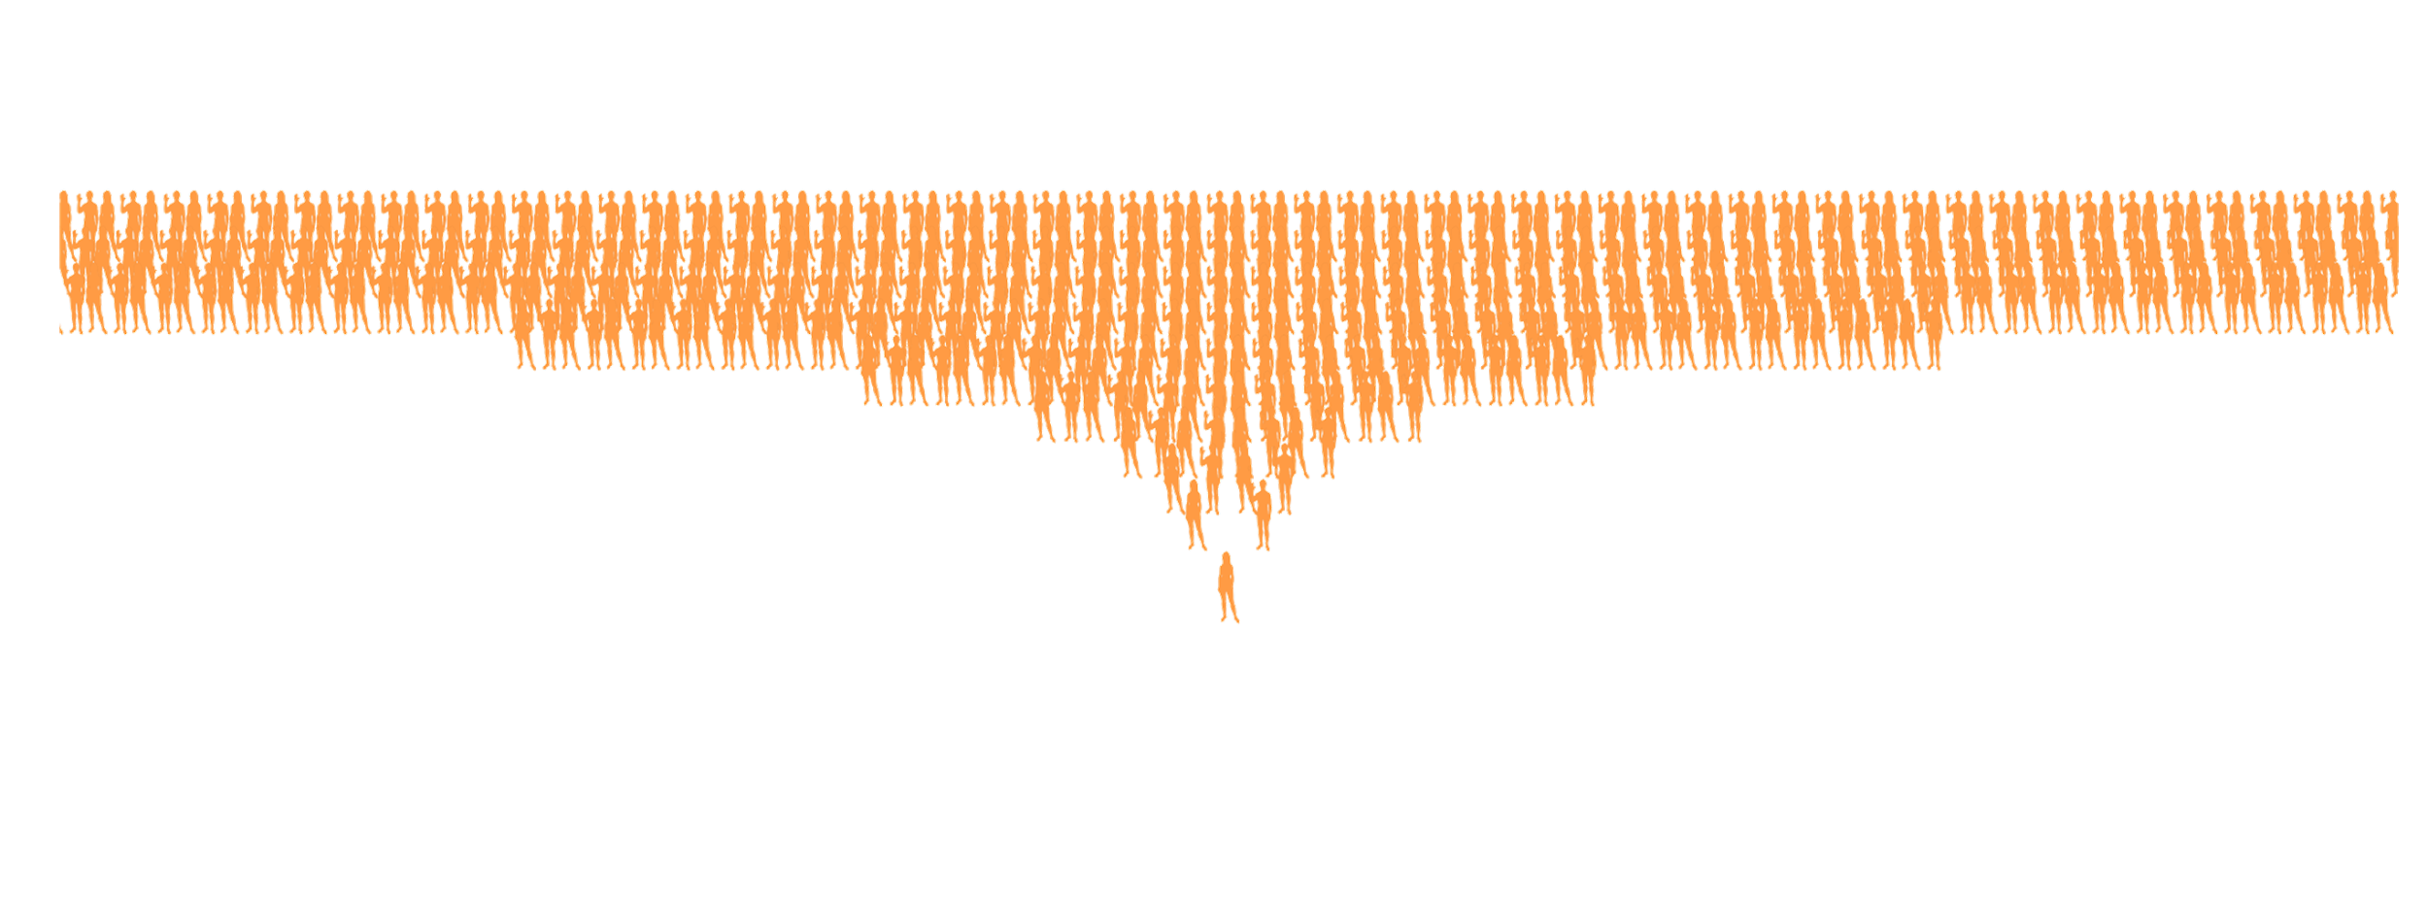
40 generations ago, you would have > 1 trillion ancestors
….2500 times the population 800 years ago

Slide 5

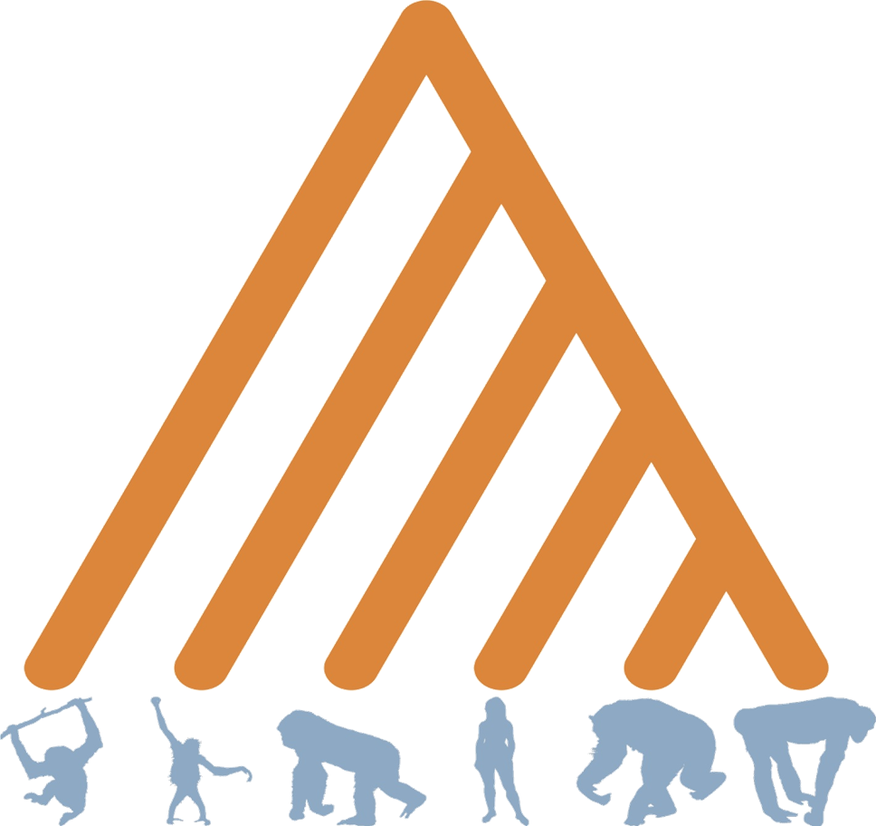

Slide 6
What happened here?

Slide 7
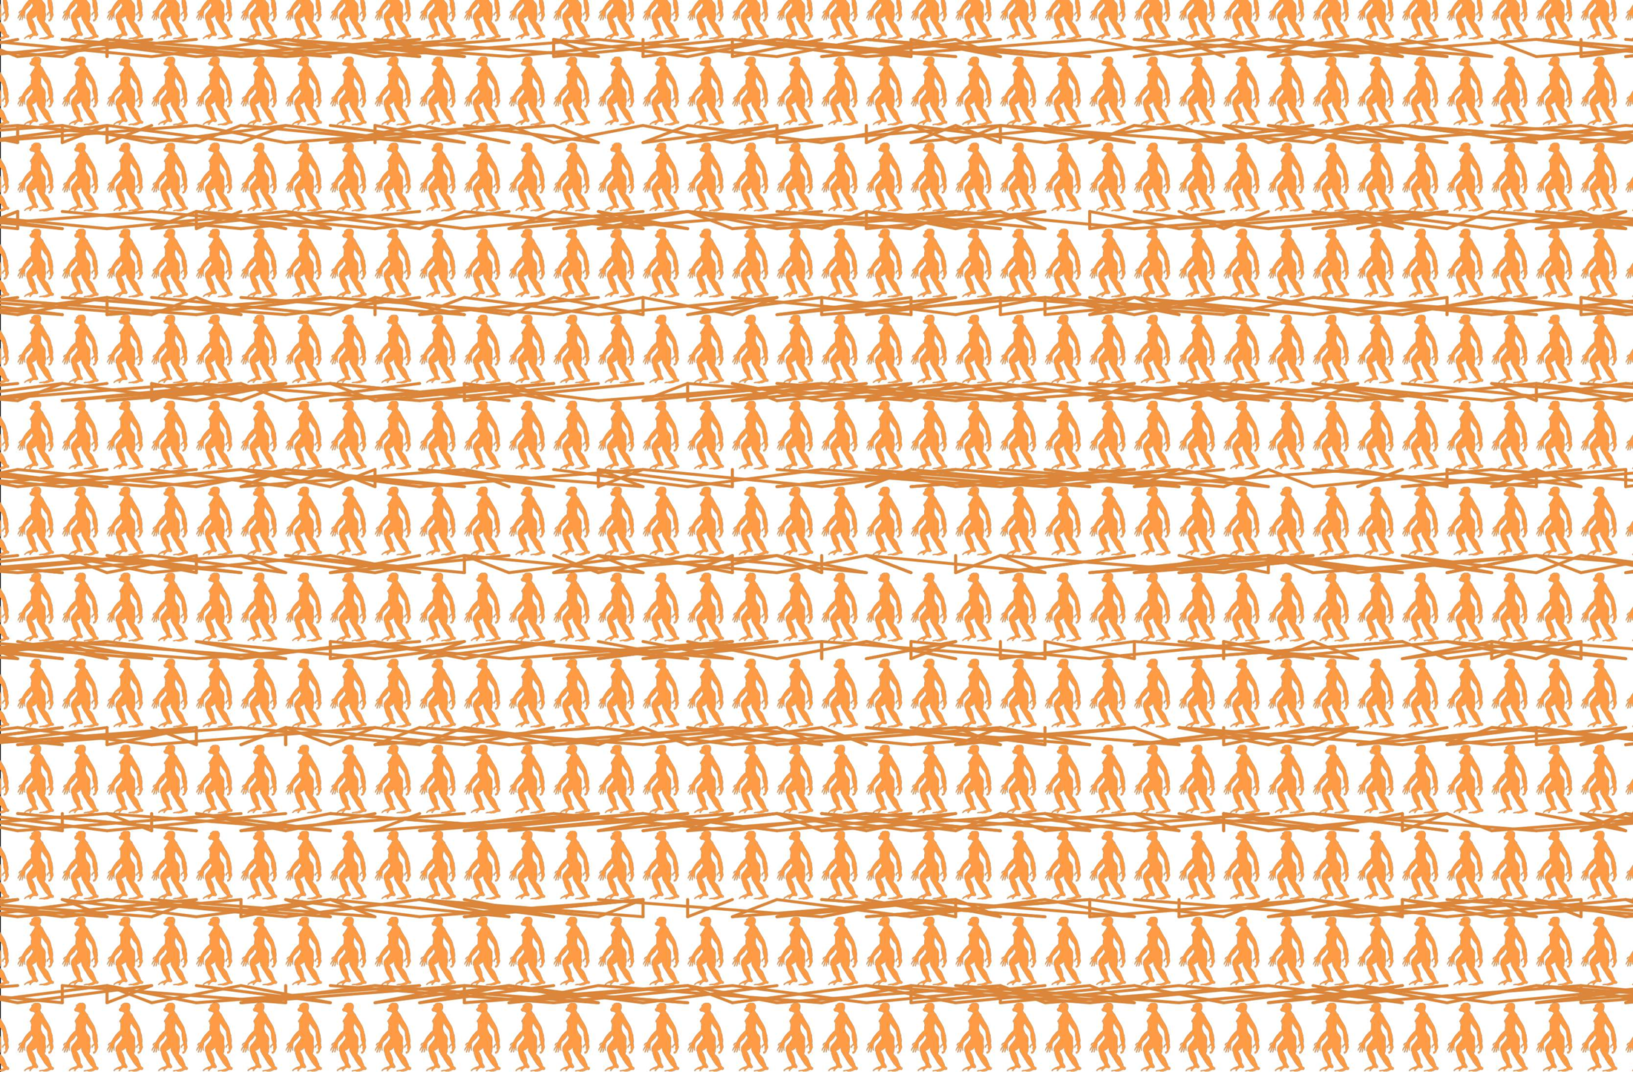
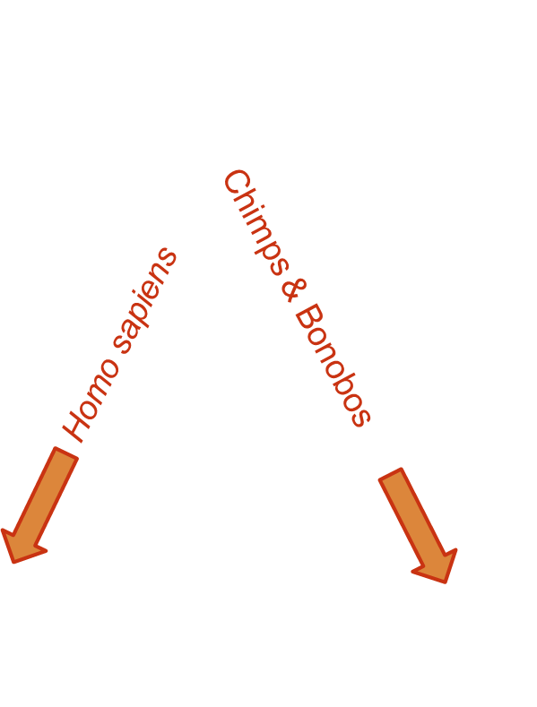
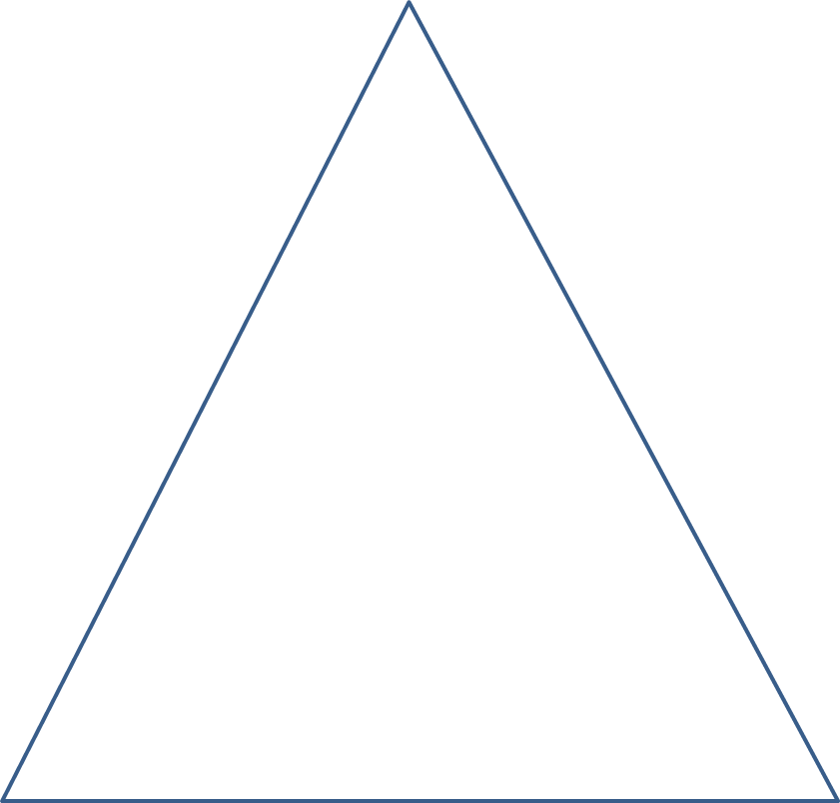
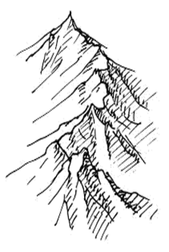
What happened here?

Slide 8
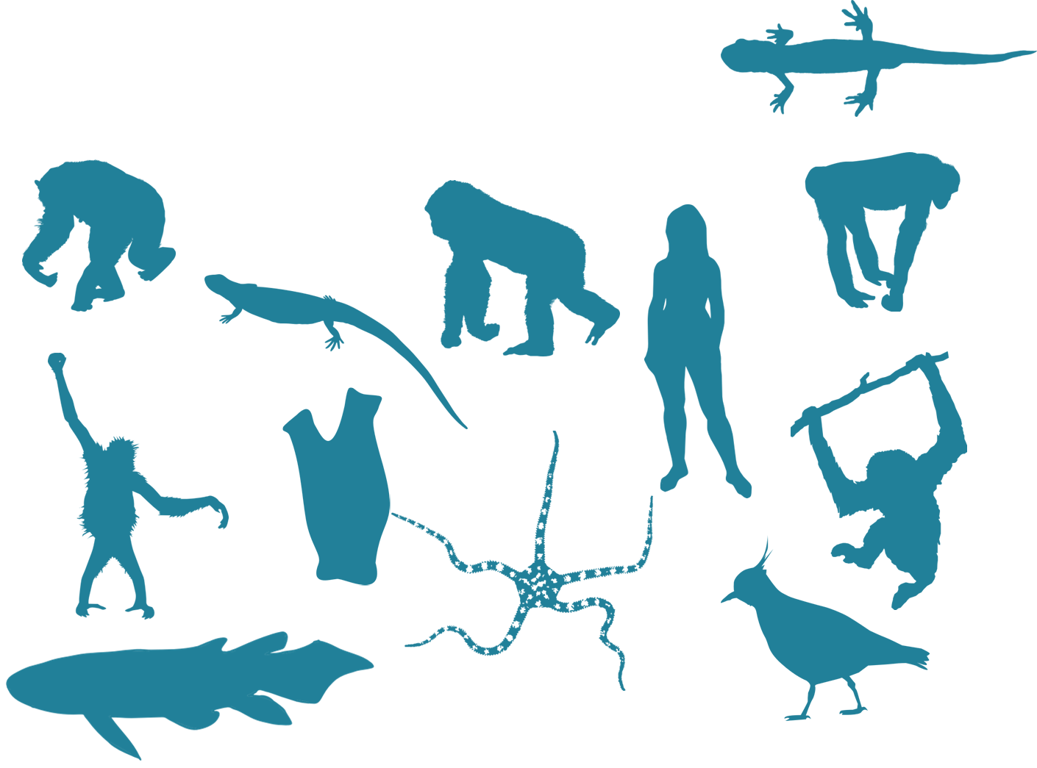
Going backwards-
Inferring phylogeny

Slide 9
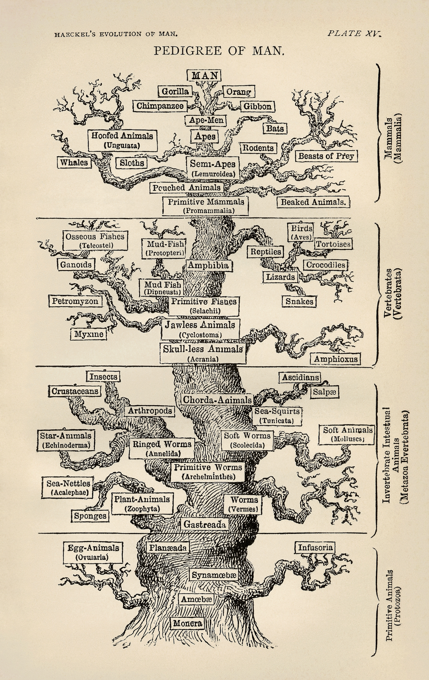
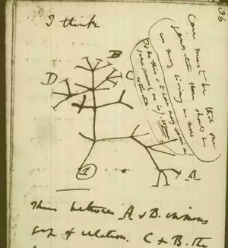
History of phylogenetic inference

Slide 10

History of phylogenetic inference
Evolutionary Taxonomy
Phenetics
Cladistics
Statistical Phylogenetics

Slide 11
History of phylogenetic inference: Evolutionary Taxonomy
No objective methodology
Relies on expert opinion & a lifetime of study

Slide 12
History of phylogenetic inference: Phenetics
Numerical Taxonomy & distance methods - measure overall similarity
How do you measure similarity?
What are the drawbacks of this approach?
Sokal, Sneath & Rohlf (1960's) argued phenetics provided much needed reproducibility

Slide 13
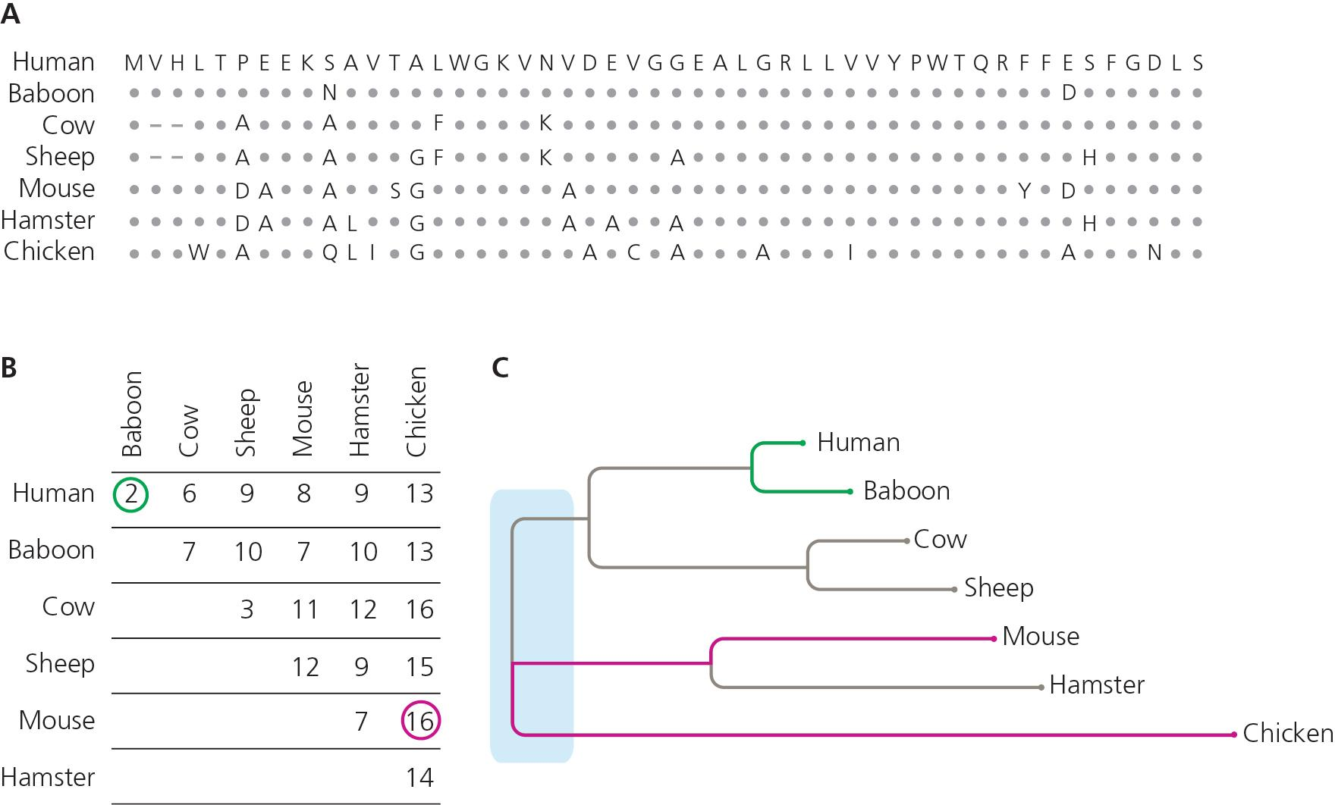

Slide 14
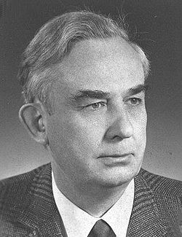
History of phylogenetic inference: Cladistics
"Phylogenetic systematics"
Argued that grouping should not be based on overall trait similarity, but only on shared derived traits (synapomorphies)
Taxonomy based on monophyly
Parsimony & Occam's Razor- The simplest explanation is probably the correct one
Willi Hennig (1966)

Slide 15

What’s the phylogenetic relationship?

Slide 16
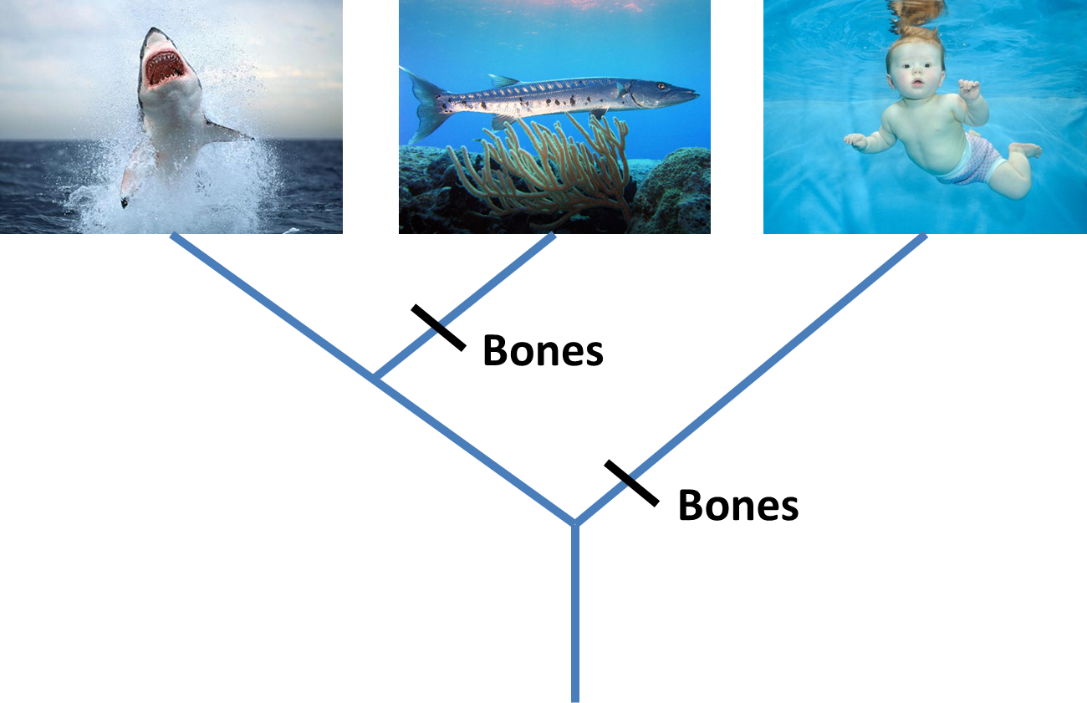

Slide 17
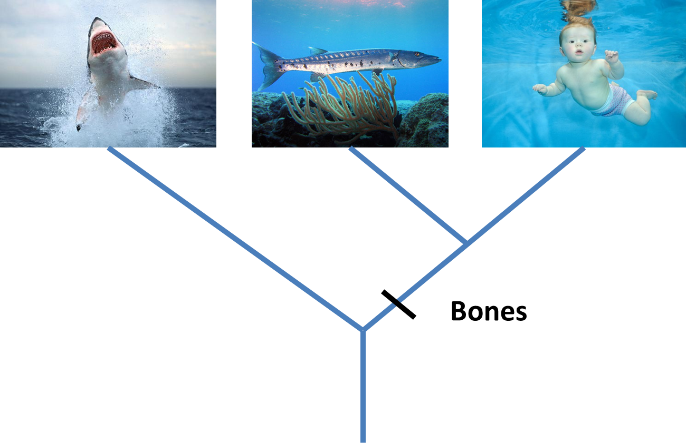
Parsimony

Slide 18
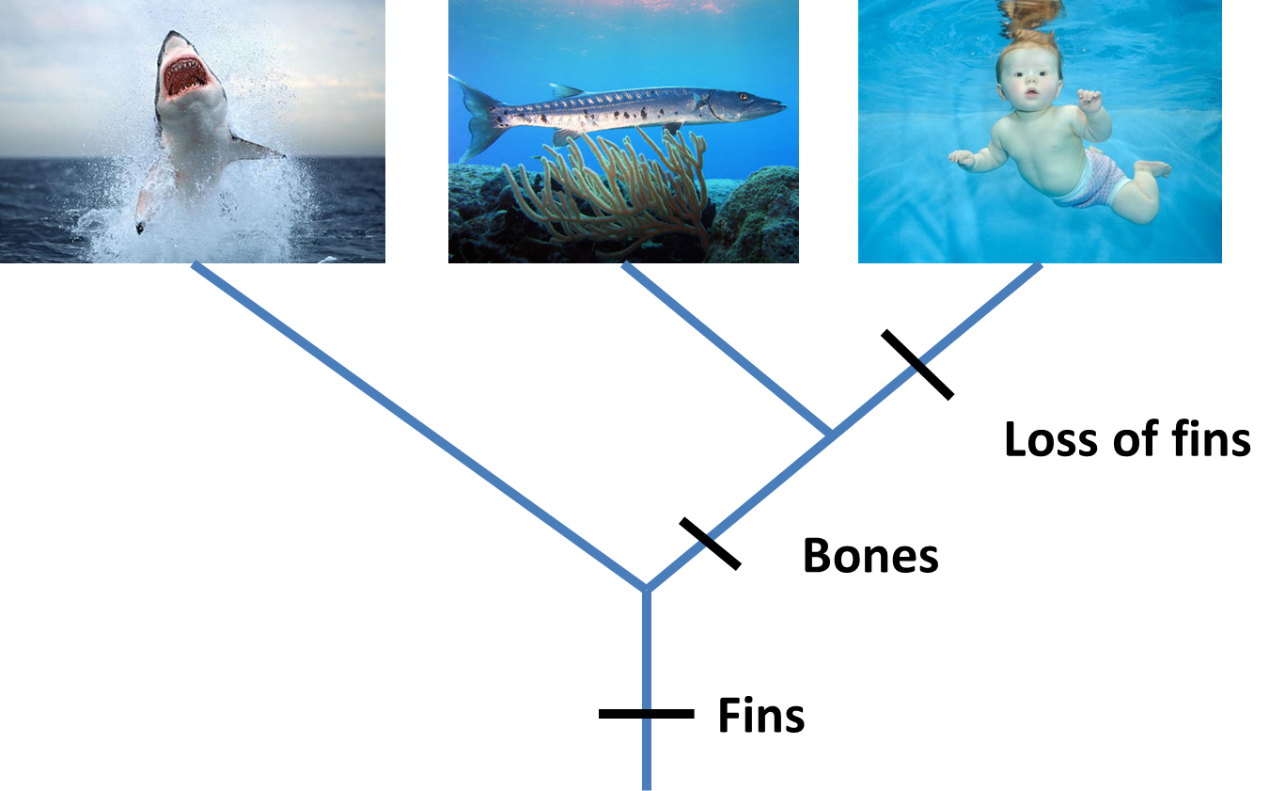

Slide 19
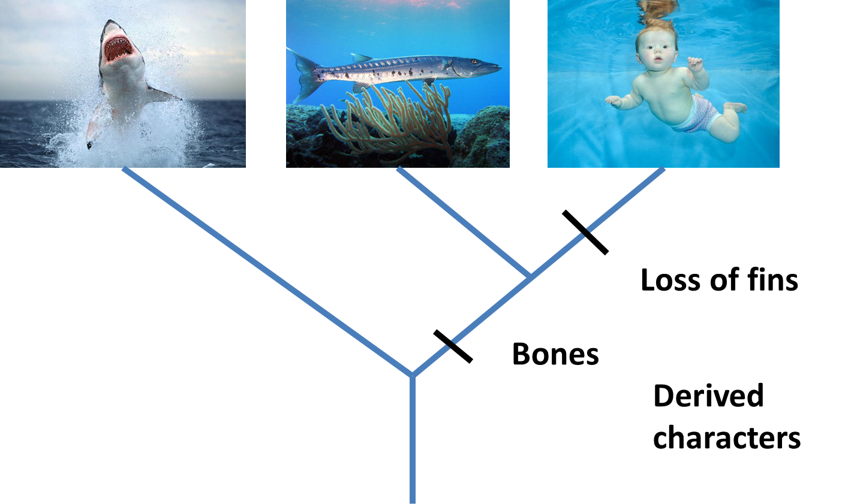
Derived Characters = Apomorphies

Slide 20
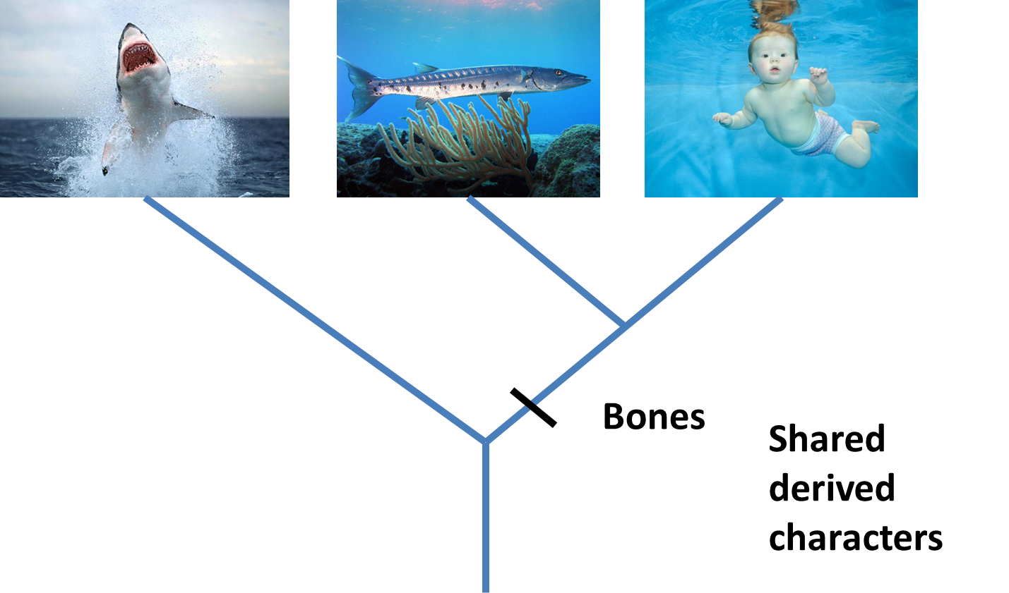
Shared derived characters = Synapomorphies

Slide 21

Shared ancestral characters = Symplesiomorphies

Slide 22
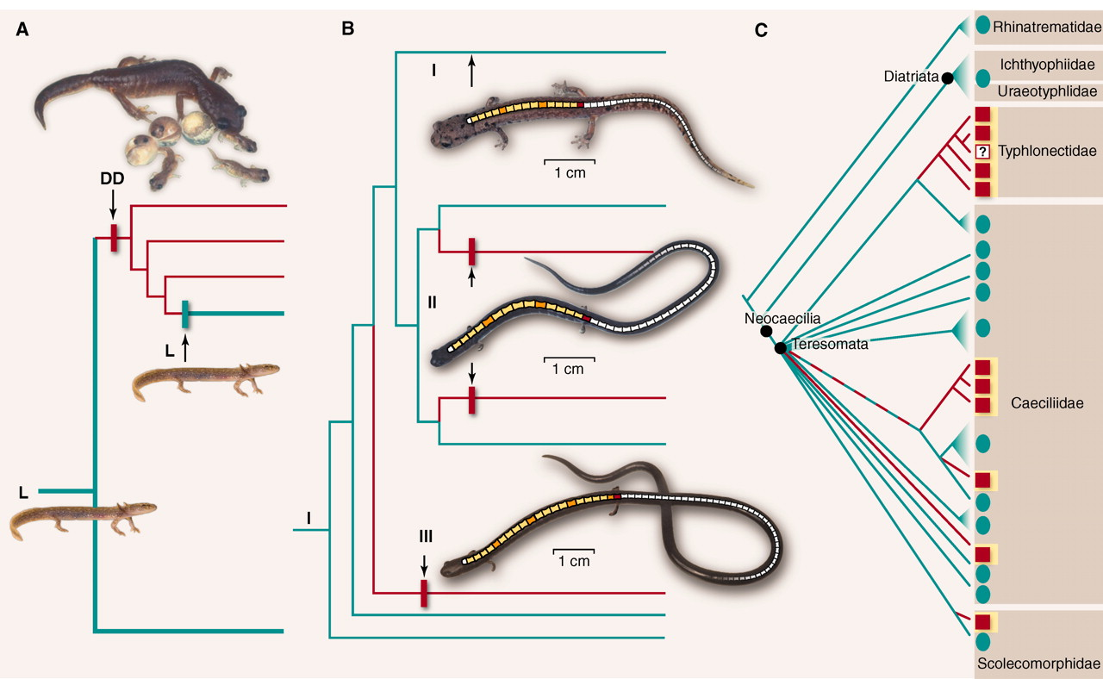
Conflict = Homoplasy

Slide 23
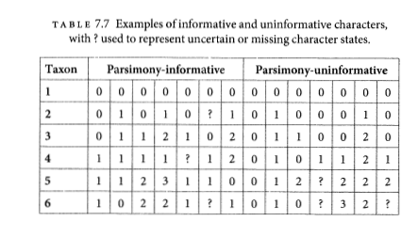
Parsimony informative vs. uninformative

Slide 24
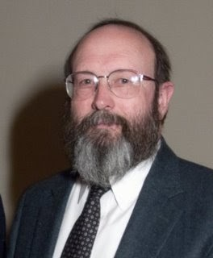
History of phylogenetic inference: Statistical phylogenetics
Luca Cavalli-Sforza, Anthony Edwards and later, Joseph Felsenstein
Probabilistic models of trait evolution
Showed statistical issues with parsimony, e.g. "the Felsenstein zone"
Maximum Likelihood & Bayesian inference
Joe Felsenstein

Slide 25
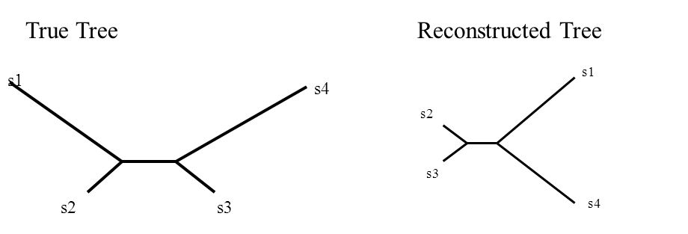
The Felsenstein Zone & "Long-branch attraction"
More generally, parsimony fell out of favor for molecular data due to more flexibility in incorporating substition models in statistical phylogenetics

Slide 26
Parsimony has unclear assumptions about evolution (rare changes, "no common mechanism")
Inconsistent estimator - An estimator that gets more and more certain of the wrong answer as more data is added

Slide 27
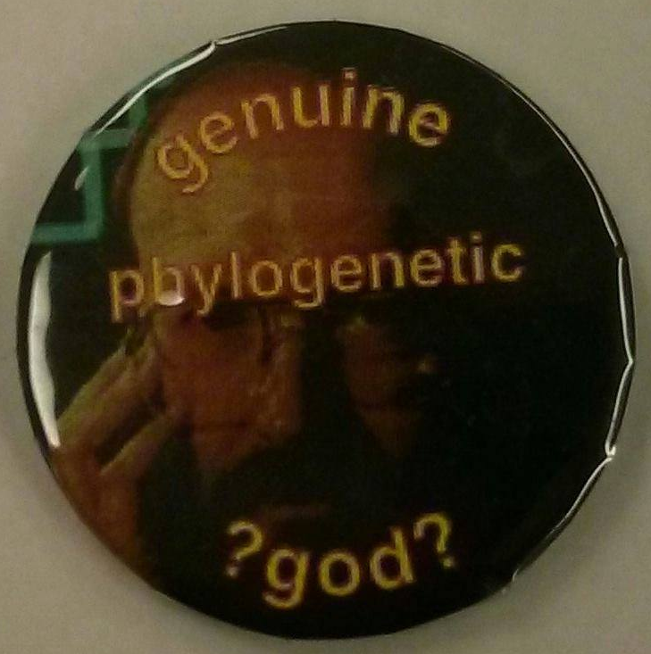
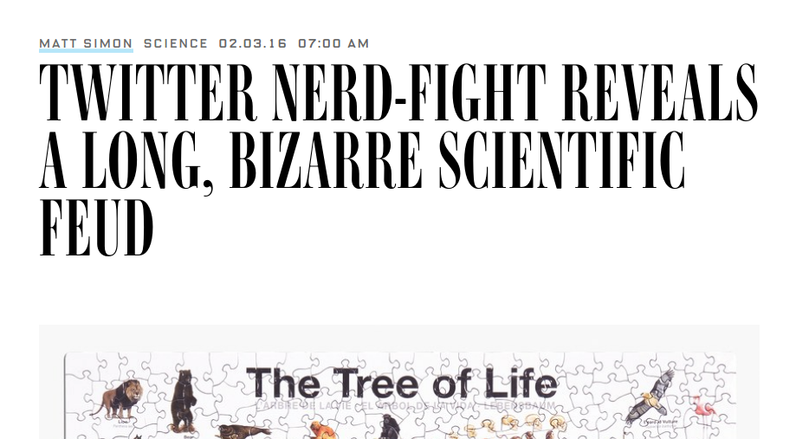
Conflict in science
#ParsimonyGate

Slide 28
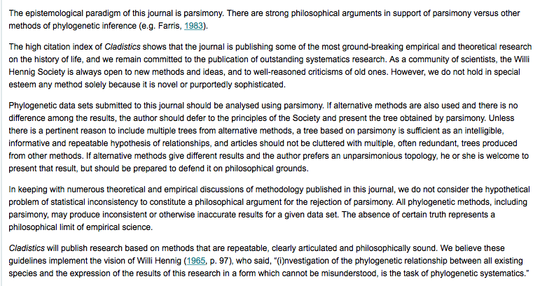

Slide 29
Parsimony still commonly used for:
Morphological analyses (though probabilistic models exist here too)
Starting trees
Understanding history of trait change

Slide 30
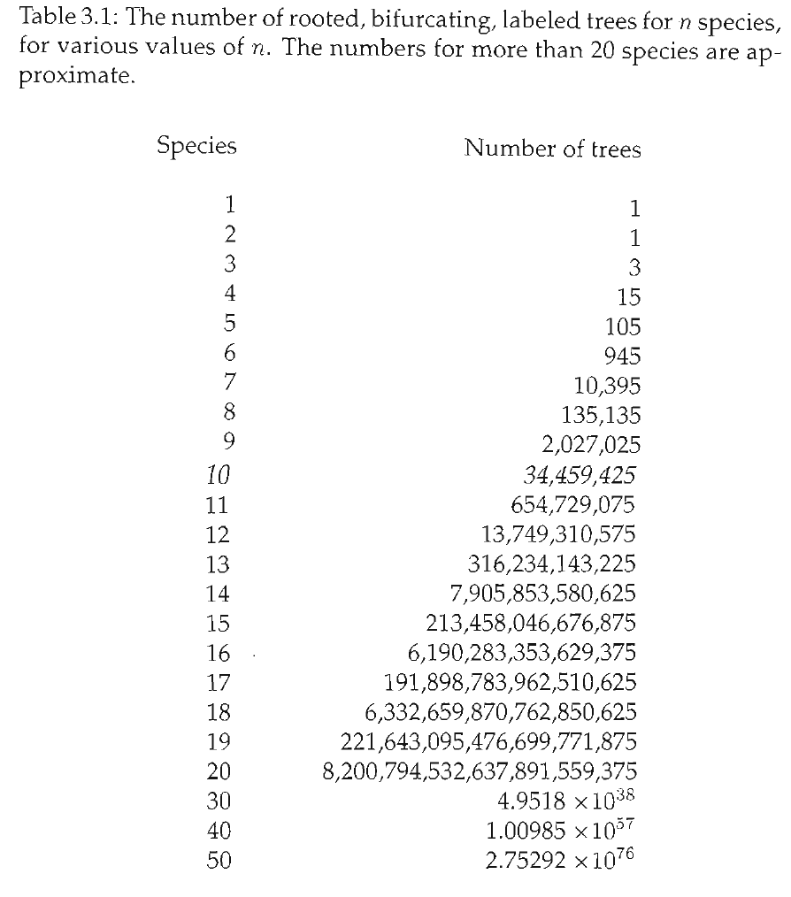
Finding the most parsimonious tree(s) - Maximum Parsimony
Tree space is huge!!

Slide 31
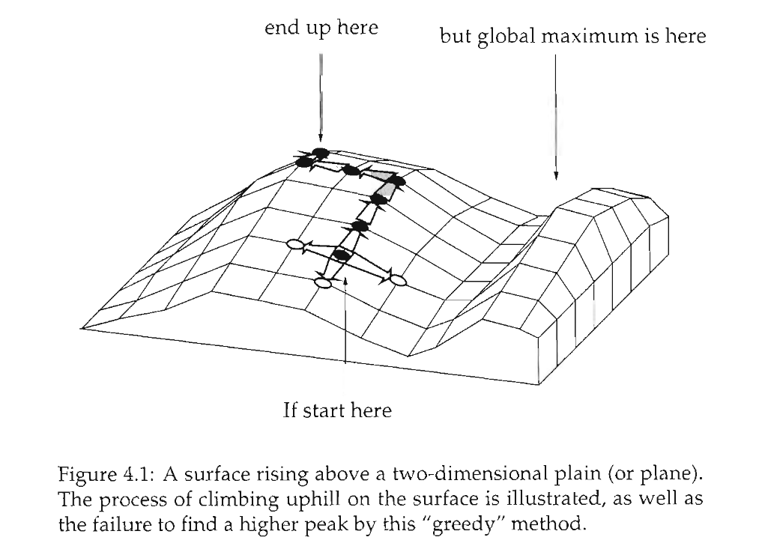
Heuristic searches

Slide 32
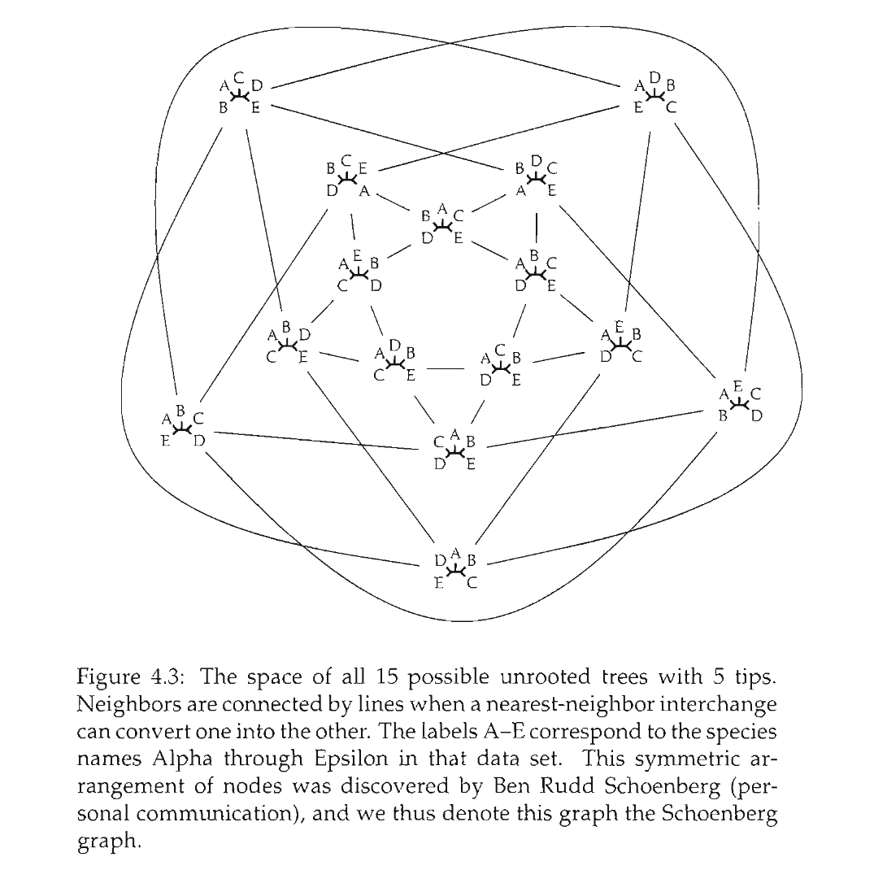

Slide 33
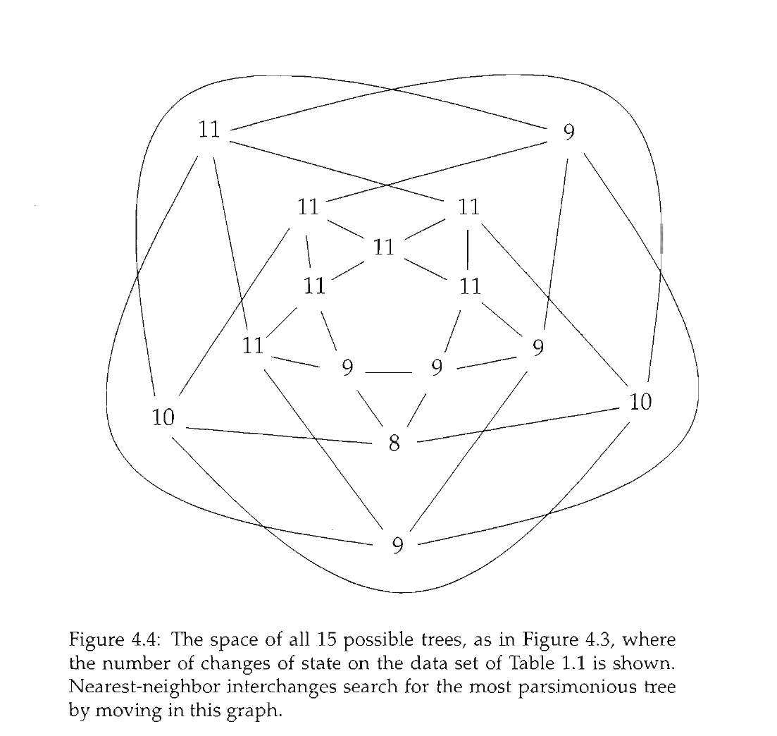

Slide 34
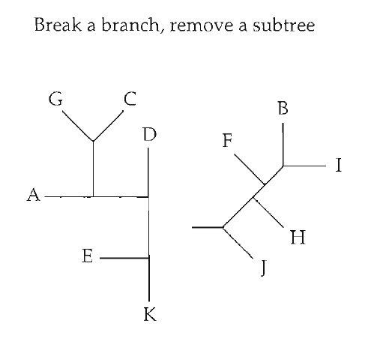
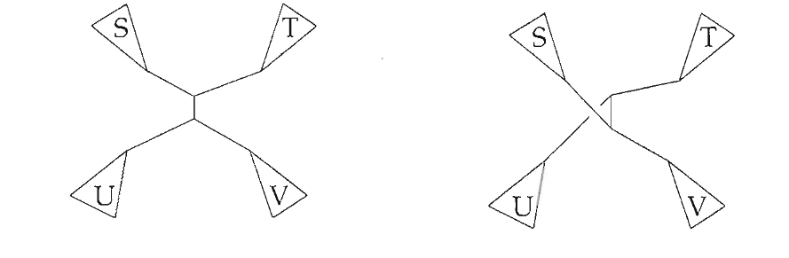
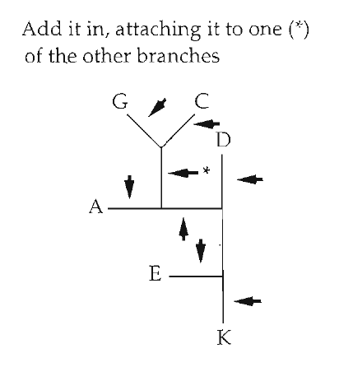
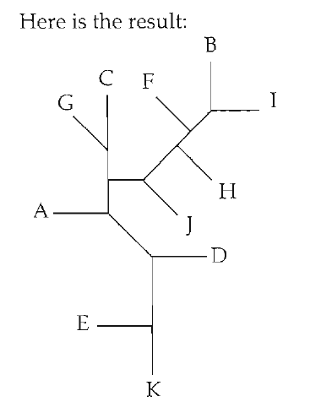
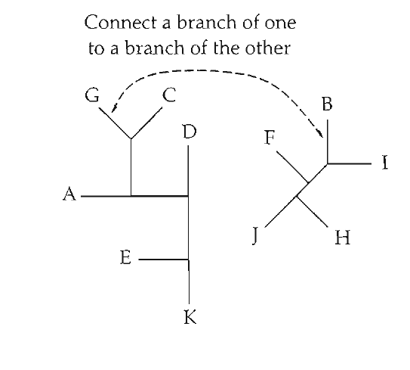
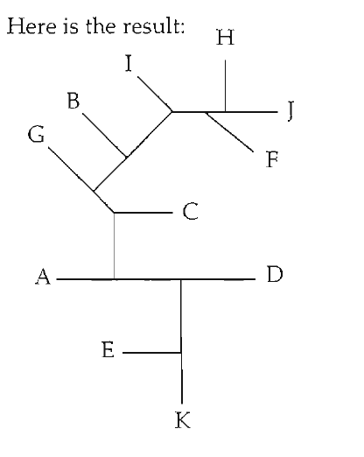
Tree space "moves"
Nearest Neighbor Interchange (NNI)
Tree bisection and reconnection (TBR)
Subtree pruning and regrafting (SPR)

Slide 35
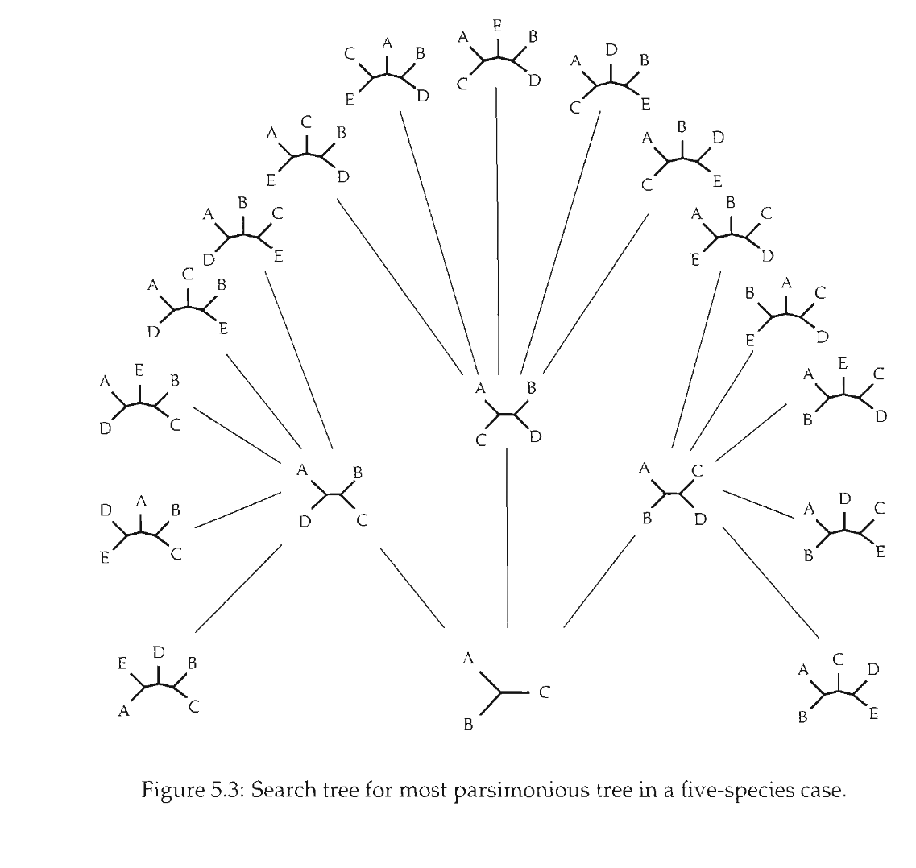
Branch and bound

Slide 36
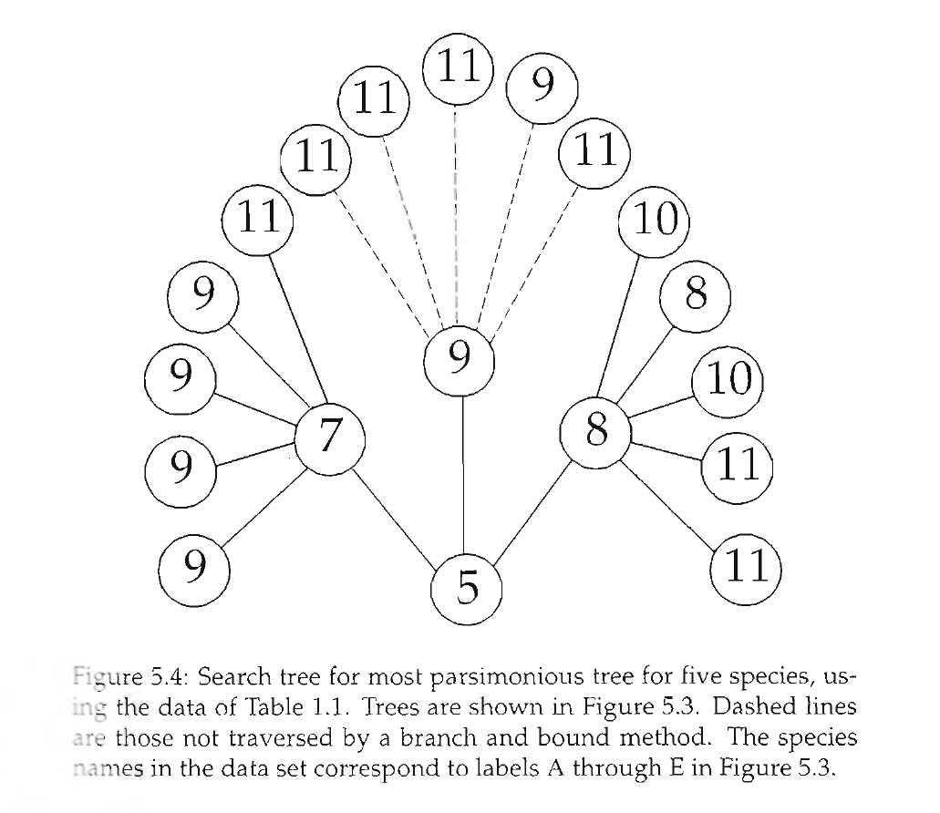
Branch and bound

Slide 37
Software: PAUP*, TNT, Mesquite, others...

